Slide 1
Object Recognition Framework for Streaming Video
Project Number: 2015385
Sanjana Kambalapally
MD Rayun Mehrab
Jonathon Wong

Slide 2
Overview
Background and Motivation
Project Goal
Project Overview
System Level Overview
Progress Update

Slide 3
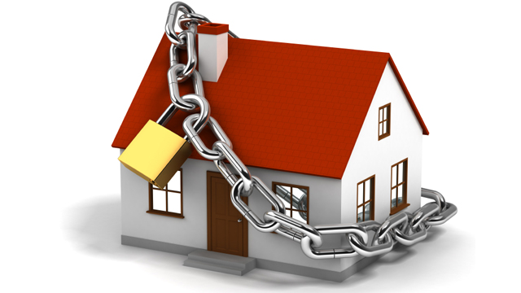
Home Security

Slide 4
How secure are we now?
In 2011, break-ins were one of the most common forms of property crime in Canada. [6]
Police reported over 181,200 break-ins [6]
63% of these break-ins were in residential areas [6]

Slide 5
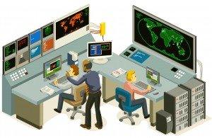
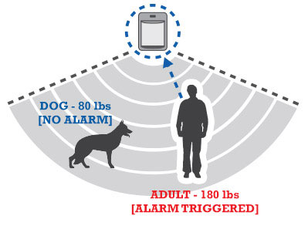
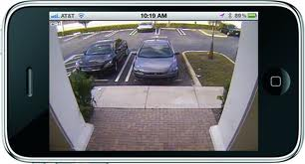
Types of Home Monitoring Systems
Human-based
Machine-based

Slide 6
Challenges with the current systems
Human error accounts for 52 percent of the root cause of security breaches [7]
Machine-based systems aren’t smart enough
Notes:
According to a new study ______
These are the problems, now how can we optimize this?

Slide 7

Balance between systems
Responsibility split between both human and machine
Notes:
Our answer is balance

Slide 8
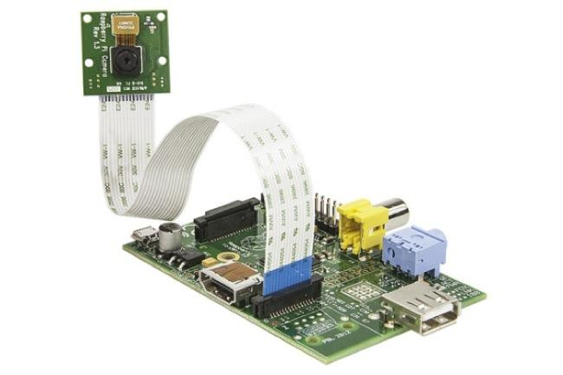
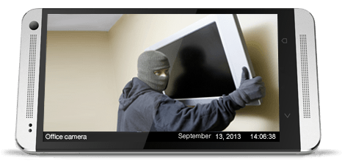

Project Goal
Develop a real-time semi-automated monitoring system that reduces the load on an end-user
Wi-Fi

Slide 9
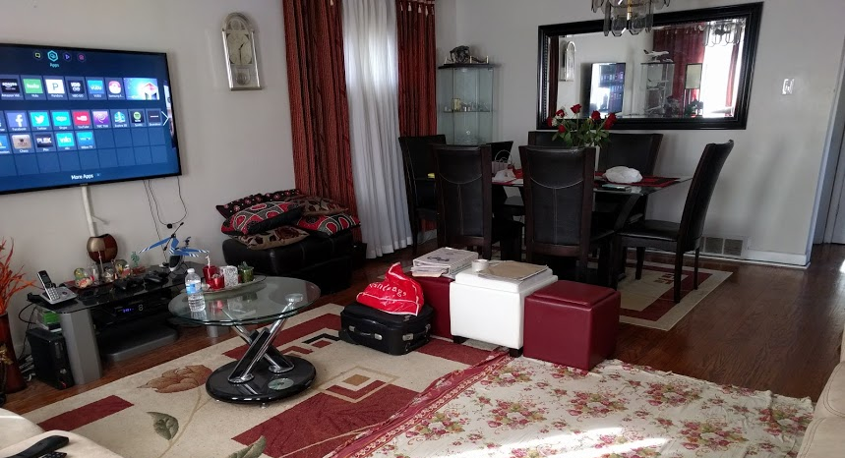
Project Overview - What Does It Do?
Continually monitors a target section of a room
Detects security threats based on set parameters
Allows manual selection of parameters
Relays back relevant information
Notes:
This is how we solve the issue

Slide 10
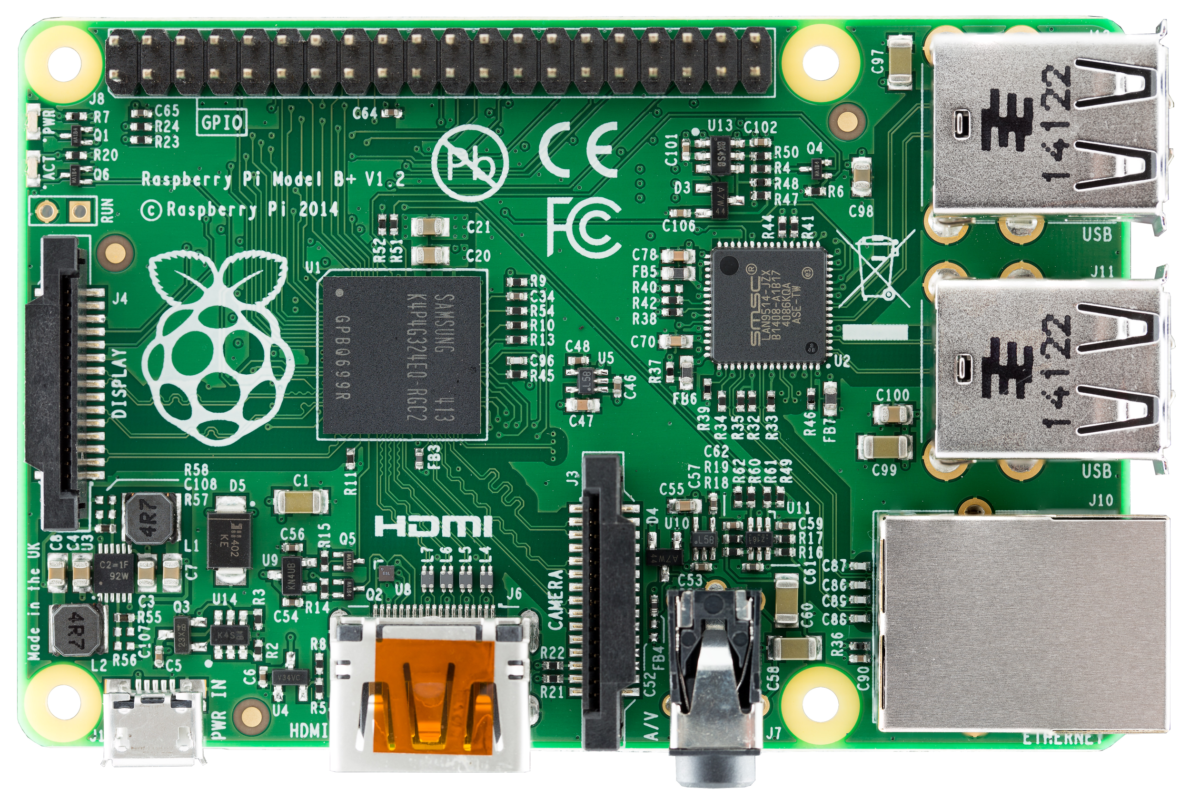

Project Overview - How does it work?
Raspberry Pi receives video feed from RaspiCam and processes it
This allows for decision making on when certain events occur
Transmits feed to user on their android device via TCP
Alerts the user using notifications

Slide 11


Project Overview - Limitations
Video must be processed at a minimum of 18 frames per second [8]
Camera must have a field of view of at least 90 degrees
The overall cost of the project must be less than 45$/month [9][10]

Slide 12
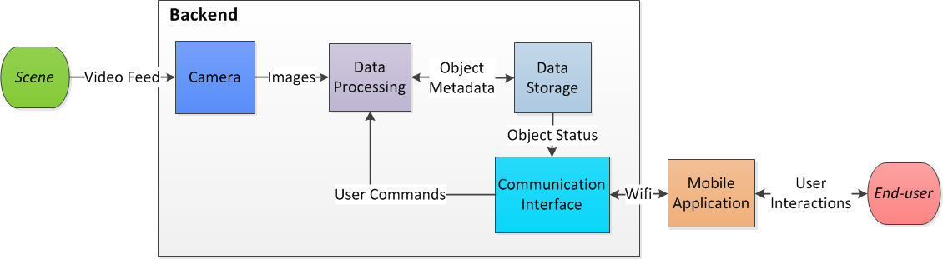
System-level Overview
Raspberry Pi (backend) processes images from a RaspiCam (camera)
Relevant information sent to Android app (mobile application)
Notes:
High level overview of flow of information

Slide 13
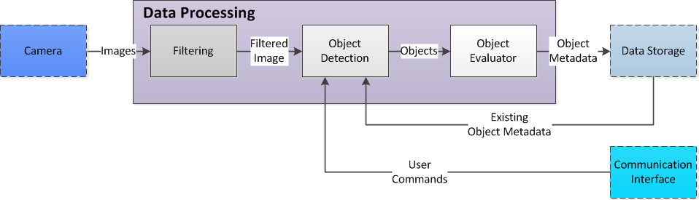
What happens on the Raspberry Pi?
Images are filtered
Objects are detected and segmented
Metadata is extracted and stored for tracking

Slide 14
So far...
Images have been gathered, filtered
Objects have been determined and stored

Slide 15
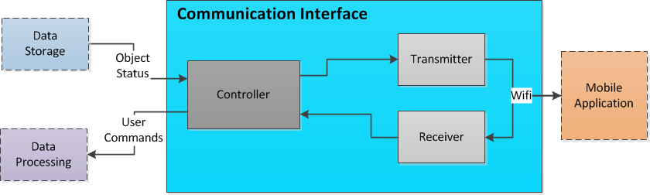
Flow of Information
Object information (metadata) is sent to controller module
Controller module mediates flow of information within Raspberry Pi
Transmitter and Receiver handle information between Raspberry Pi and user

Slide 16
Example scenario

Slide 17

What needs to be done
Task | Completed | In progress
Test latency of various processing algorithms and memory usage
Read and store video frames captured by the RaspiCam
Send a String and an image between the RaspiCam (C++) and Android application(Java)
Store object metadata in a designed structure
Notes:
Progress update

Slide 18
What needs to be done (continued…)
Task | Completed | In progress
Apply various pre-filters to video frames
Implement Android user interface to receive video and alerts
Send a series of video frames between Raspberry Pi and Android application
Integrate Android user interface with backend
Test output and performance of the software
Notes:
Progress update

Slide 19
Conclusion
Human Based
Machine Based
Wi-Fi

Slide 20
Thank You
Any Questions?

Slide 21
Sources
[1] http://www.cbc.ca/stevenandchris/content/images/holiday_home_security.jpg
[2] http://yourlocalsecurity.com/images/yls_responsive/resources/xsensors-triggers.jpg.pagespeed.ic.JaQl9yp_qK.jpg
[3] https://local.mobiscope.com/images/lp/home-small-office-security/home-office-security.png
[4] http://www.remontech.com/wp-content/uploads/2011/05/HiRes-300x195.jpg
[5] http://techli.com/wp-content/uploads/Robohand.jpg
[6] http://www.scmagazine.com/study-find-carelessness-among-top-human-errors-affecting-security/article/406876/
[7] http://www.statcan.gc.ca/pub/85-002-x/2012001/article/11692-eng.htm
[8] https://documentation.apple.com/en/finalcutpro/usermanual/index.html#chapter=D%26section=3%26tasks=true
[9] ADT Home Security (2015). ADT Monitoring Packages. [Online] Accessed Oct 3, 2015. Available: http://www.homesecurity.io/adt-packages
[10] Rogers (2015). Smart Home Monitoring Solutions. [Online] Accessed Oct 3, 2015. Available: http://www.rogers.com/web/content/smart-home-monitoring-solutions-new

